Slide 1
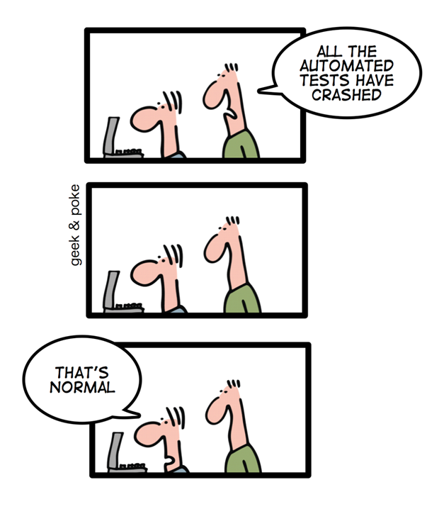
AIM > ICT > WD > DWA
end-to-end
testing

Slide 2
end-to-end testing
also known as: e2e testing
of: UI testing ☹
het idee: testscripts sturen browser aan
assertions checken de DOM
vandaag:
demo met Puppeteer
test-vormen: e2e vs. unit vs. API vs. acceptatie
andere tools

Slide 3
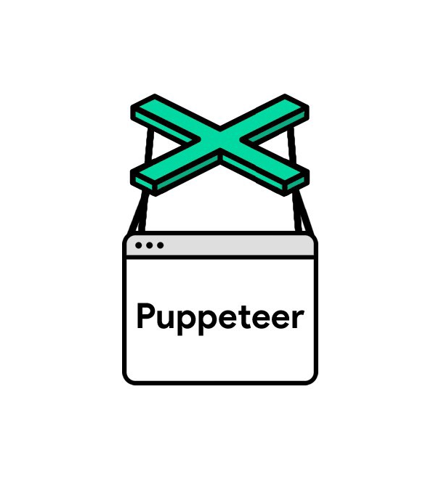
Puppeteer
door: Google Chrome team
pro’s:
Javascript
npm package
neemt eigen Chromium mee
cons:
alleen Chrome
neemt eigen Chromium mee
info: https://pptr.dev; https://jestjs.io/docs/puppeteer; en de cheatsheet in de repo.
en dan nu: demo met “Suffragium”
repo: https://github.com/HANICA-DWA/suffragium

Slide 4
Demo recap:
npm run e2e truuk om e2e tests te scheiden van andere tests
meerdere browsers starten
headless: false, sloMo: 200
browser interactie: navigeren, clicks en textinput
data van pagina ophalen
elementen zoeken
JS evalueren in browser-context
JSHandle/ElementHandle
Data uit ene browser lezen, en gebruiken in test voor andere browser
tests zonder expect-statements
actie in ene browser uitvoeren, en effect checken in andere browser

Slide 5
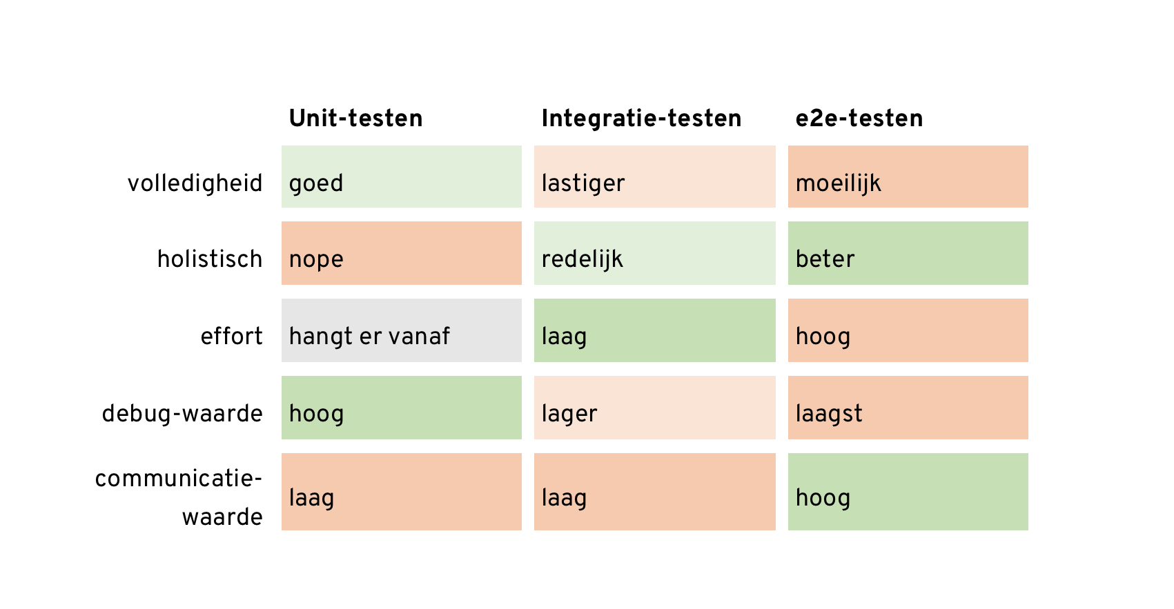
Test stijlen

Slide 6
Test stijlen

Slide 7
Andere tools
Selenium
Webdriver.io; Nightwatch.js
Playwright
Cypress.io
CodeceptJS

Slide 8
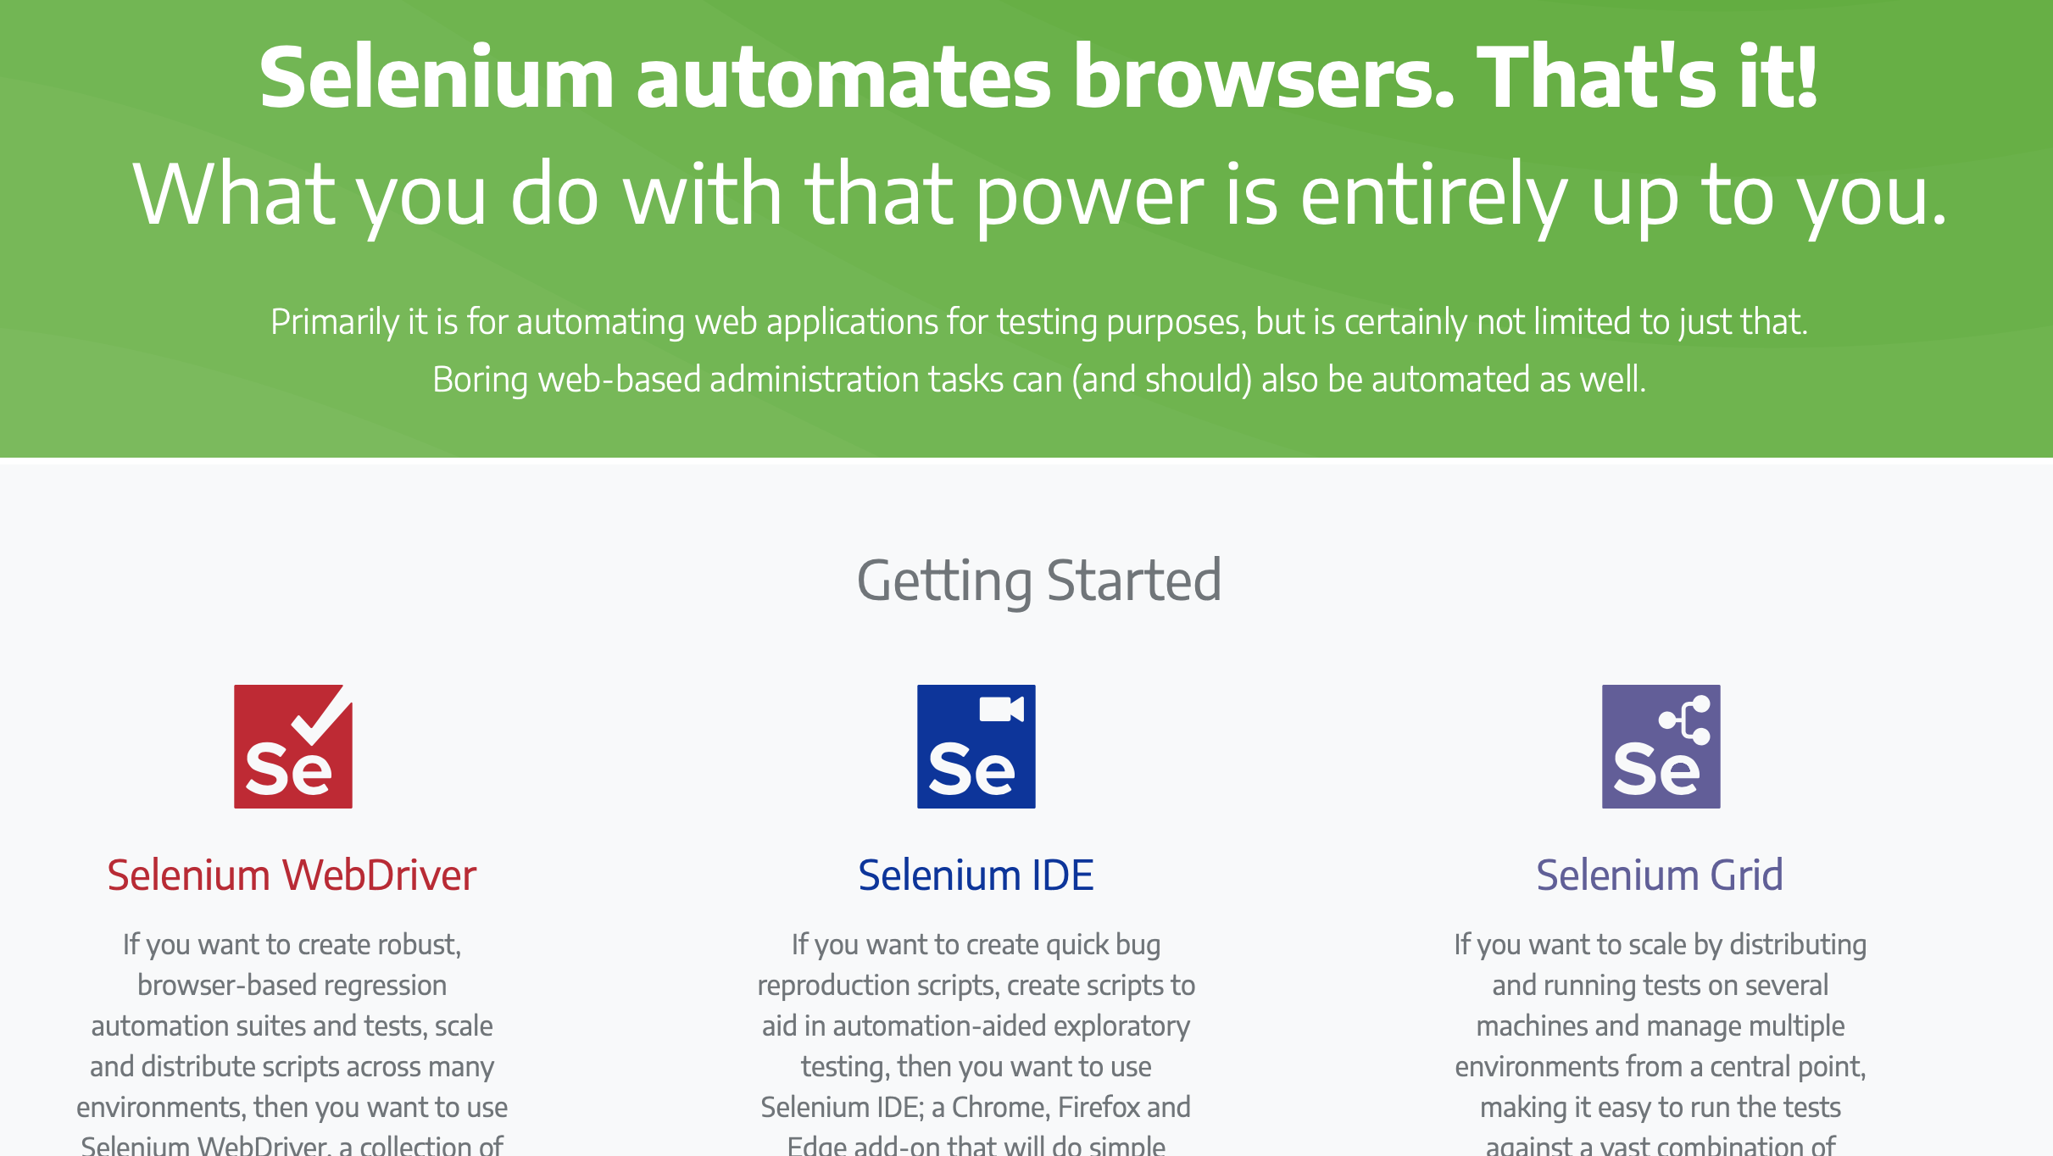
Andere tools
Selenium
Nightwatch.js
Playwright
Cypress.io
CodeceptJS

Slide 9
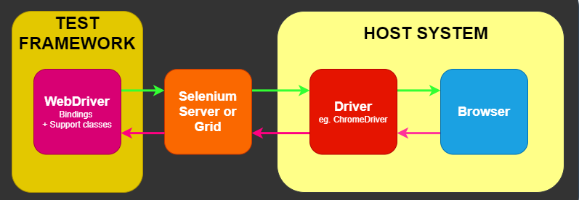
Andere tools
Selenium
Nightwatch.js
Playwright
Cypress.io
CodeceptJS

Slide 10
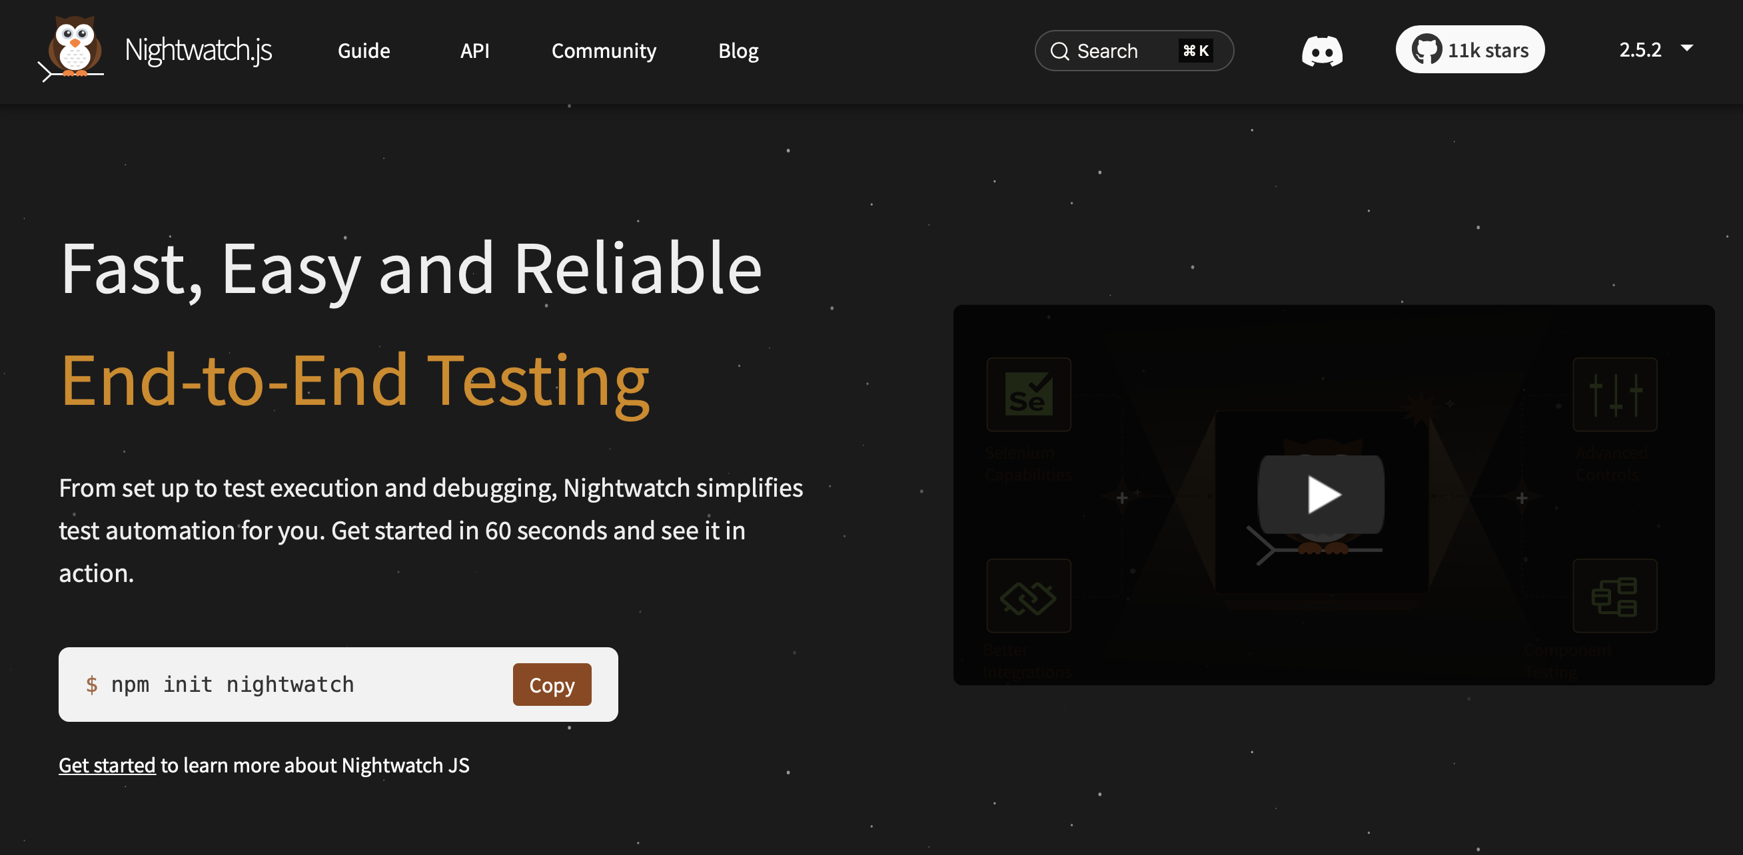
Andere tools
Selenium
Nightwatch.js
Playwright
Cypress.io
CodeceptJS

Slide 11
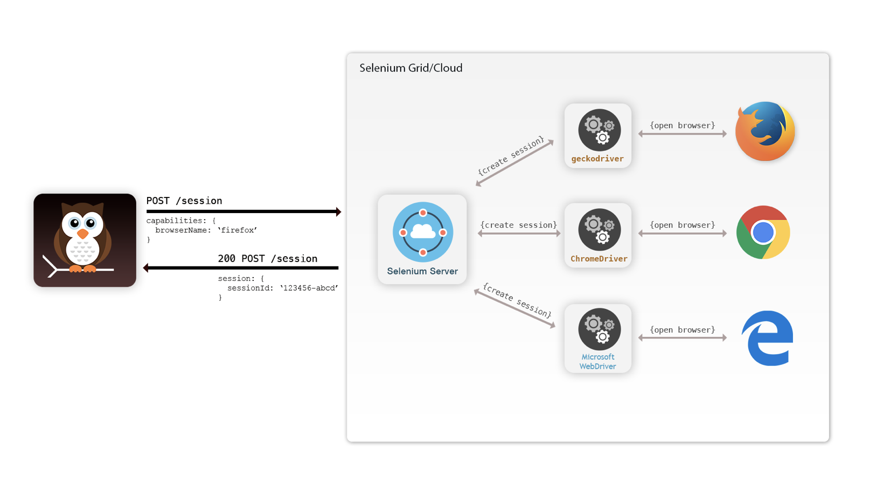
Andere tools
Selenium
Nightwatch.js
Playwright
Cypress.io
CodeceptJS

Slide 12
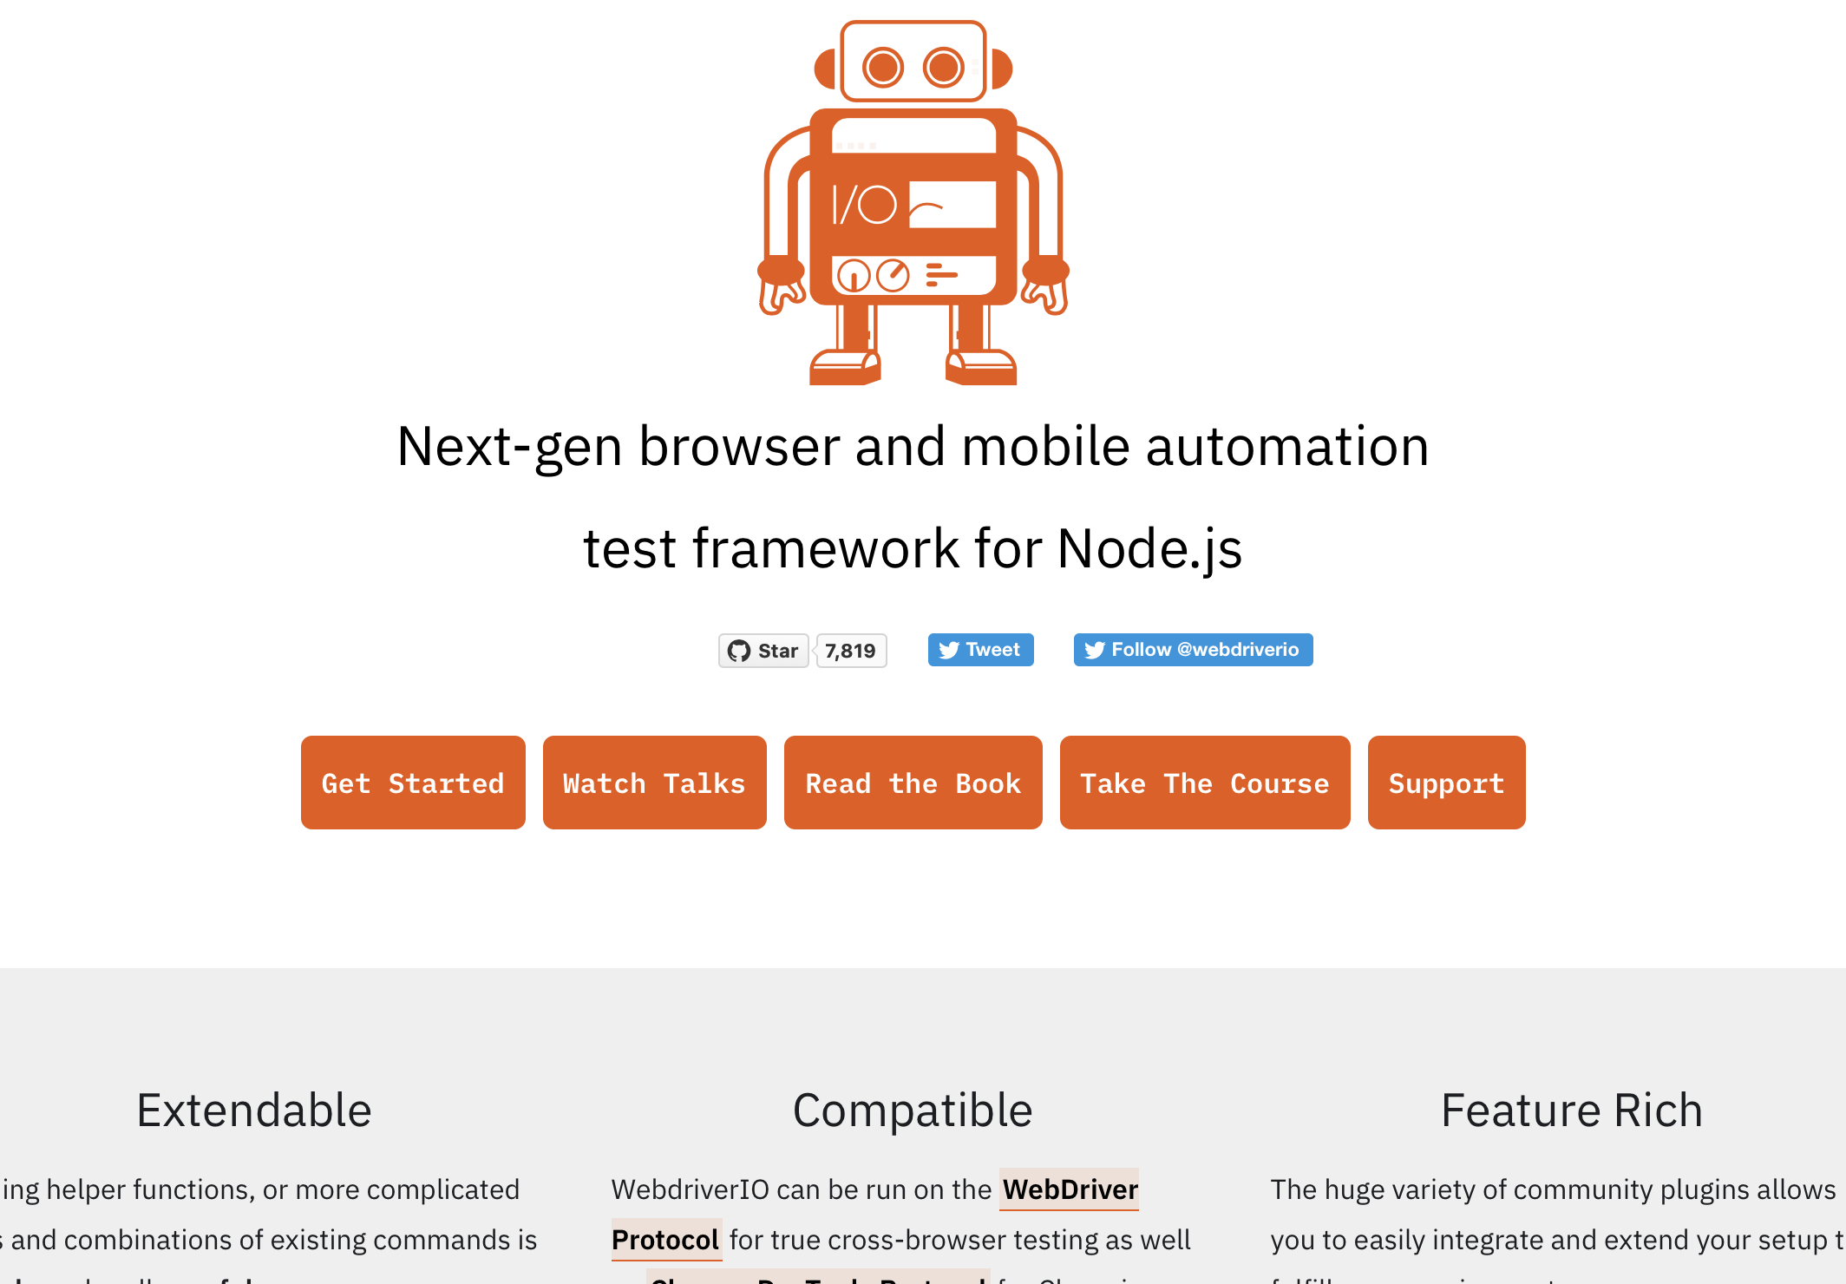
Andere tools
Selenium
Webdriver.io
Playwright
Cypress.io
CodeceptJS

Slide 13
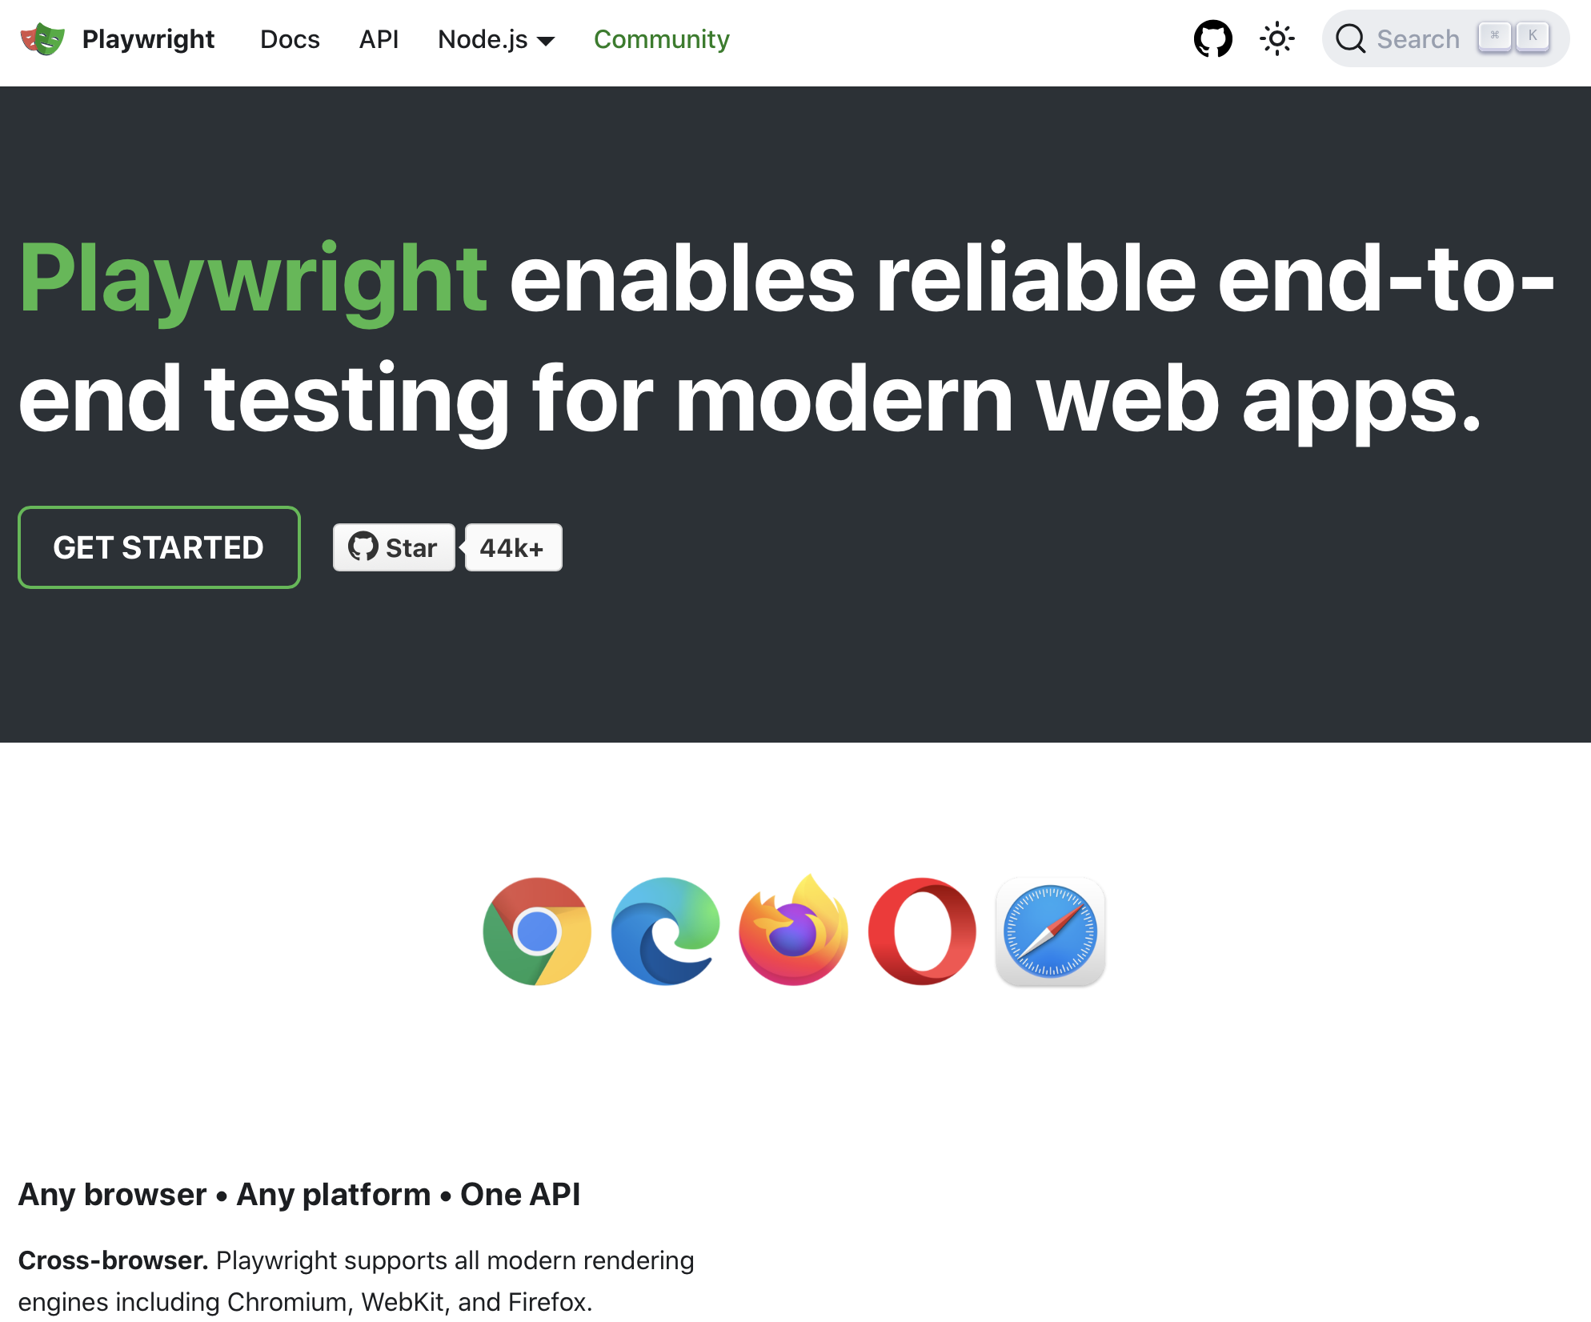
Andere tools
Selenium
Nightwatch.js
Playwright
Cypress.io
CodeceptJS

Slide 14
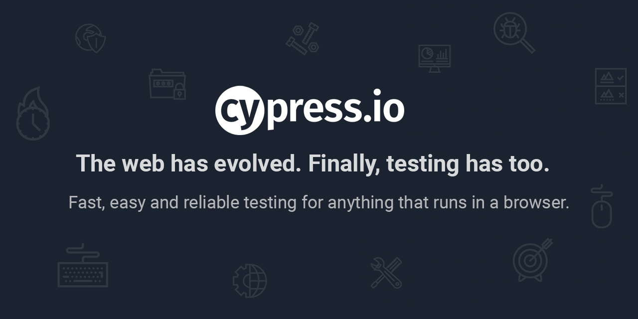
Andere tools
Selenium
Nightwatch.js
Playwright
Cypress.io
CodeceptJS

Slide 15
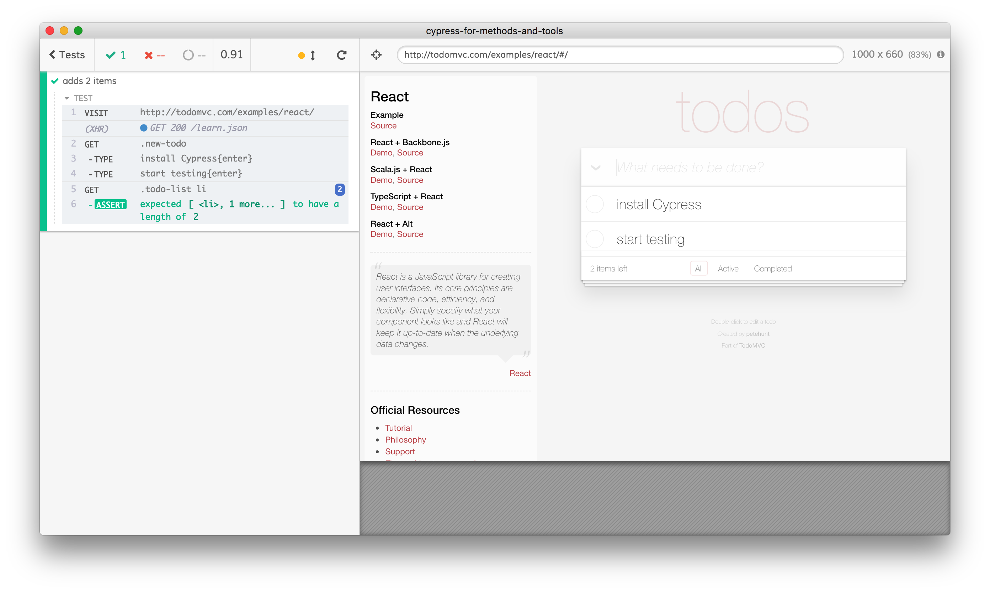
Andere tools
Selenium
Nightwatch.js
Playwright
Cypress.io
CodeceptJS

Slide 16
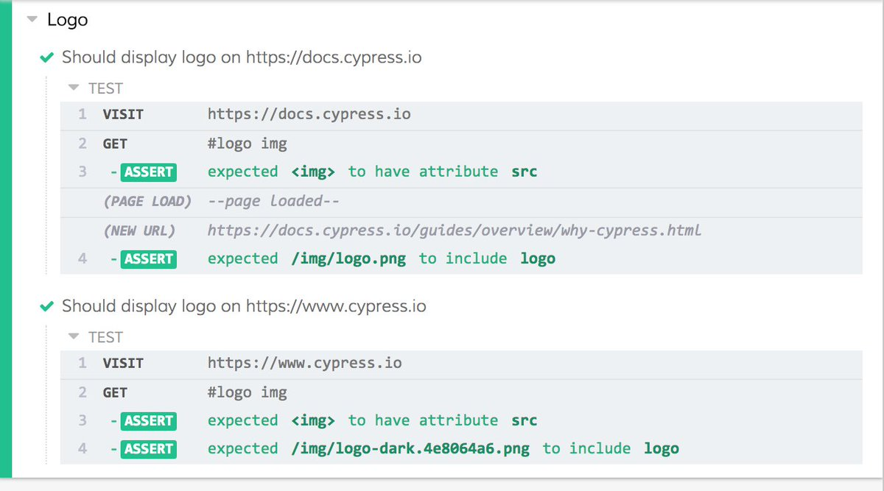
Andere tools
Selenium
Nightwatch.js
Playwright
Cypress.io
CodeceptJS

Slide 17
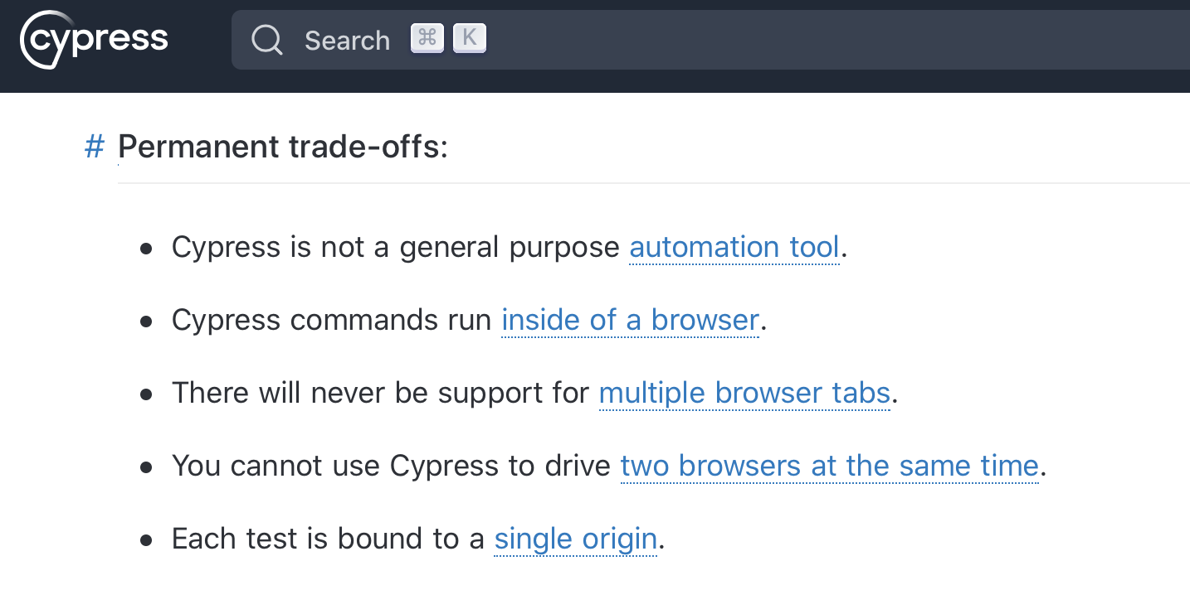
Andere tools
Selenium
Nightwatch.js
Playwright
Cypress.io
CodeceptJS

Slide 18
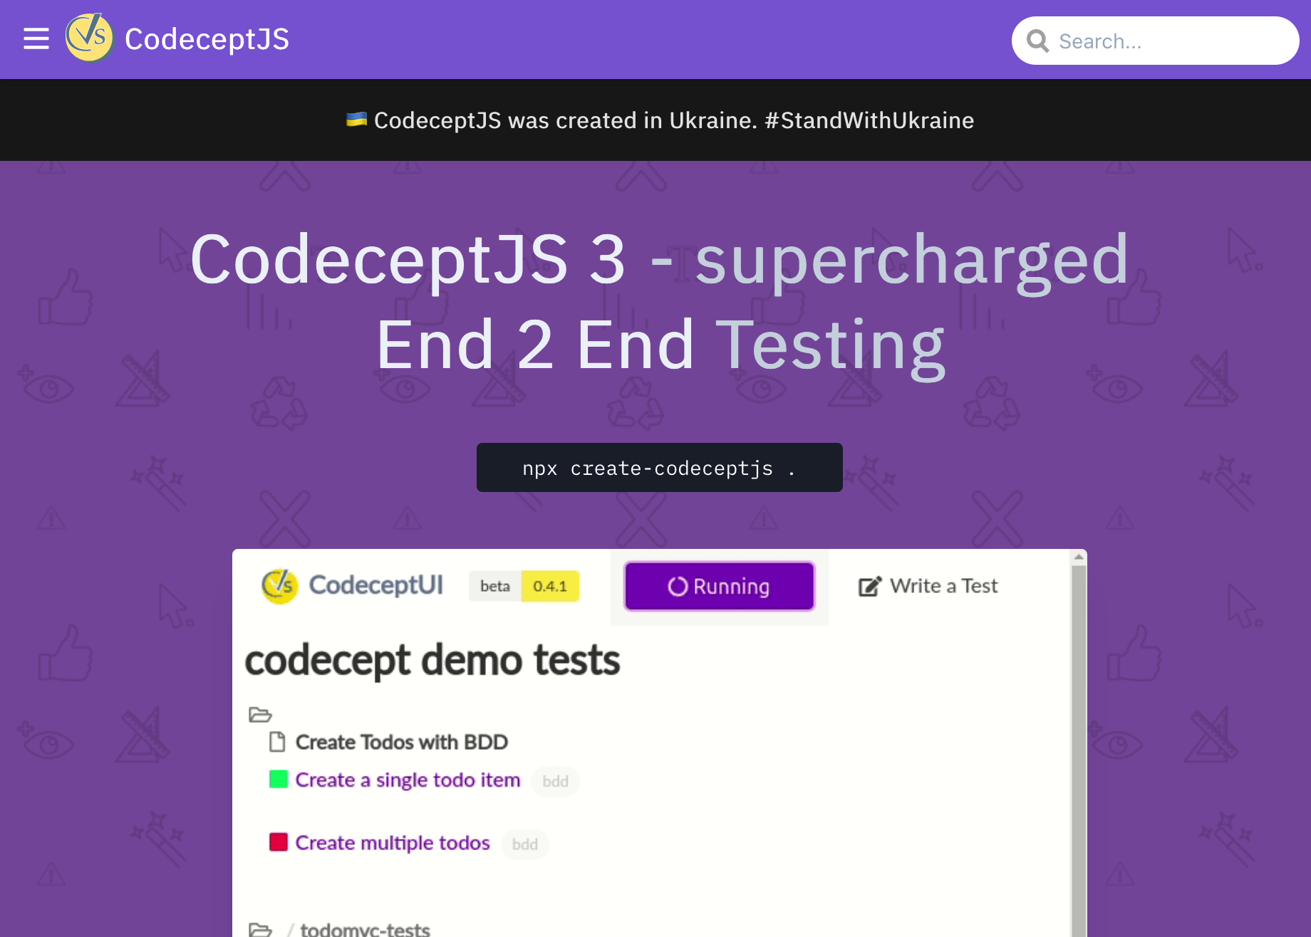
Andere tools
Selenium
Nightwatch.js
Playwright
Cypress.io
CodeceptJS

Slide 19
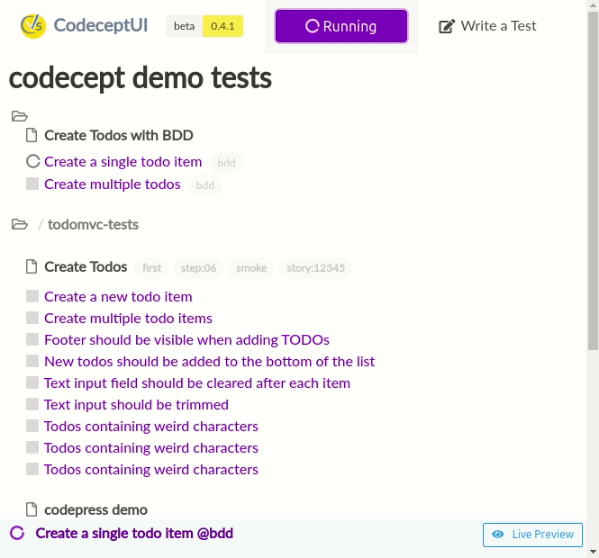
Andere tools
Selenium
Nightwatch.js
Playwright
Cypress.io
CodeceptJS

Slide 20
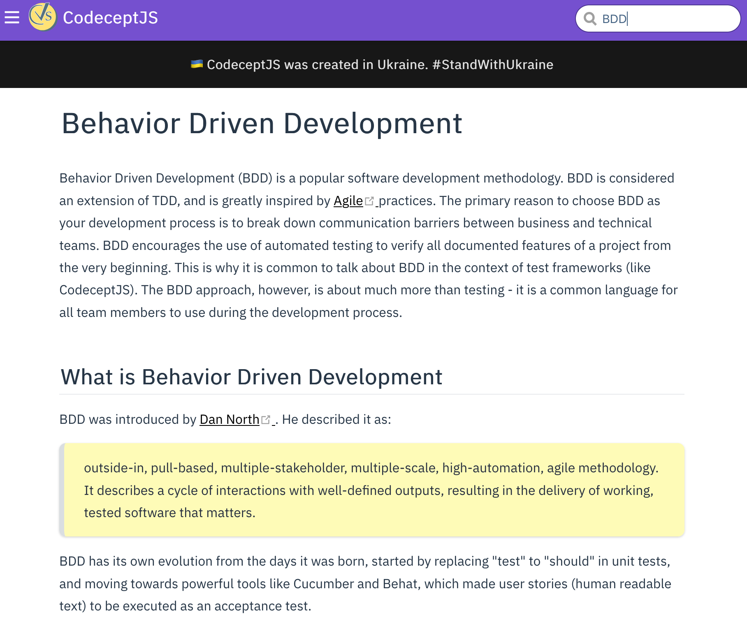
Andere tools
Selenium
Nightwatch.js
Playwright
Cypress.io
CodeceptJS

Slide 21
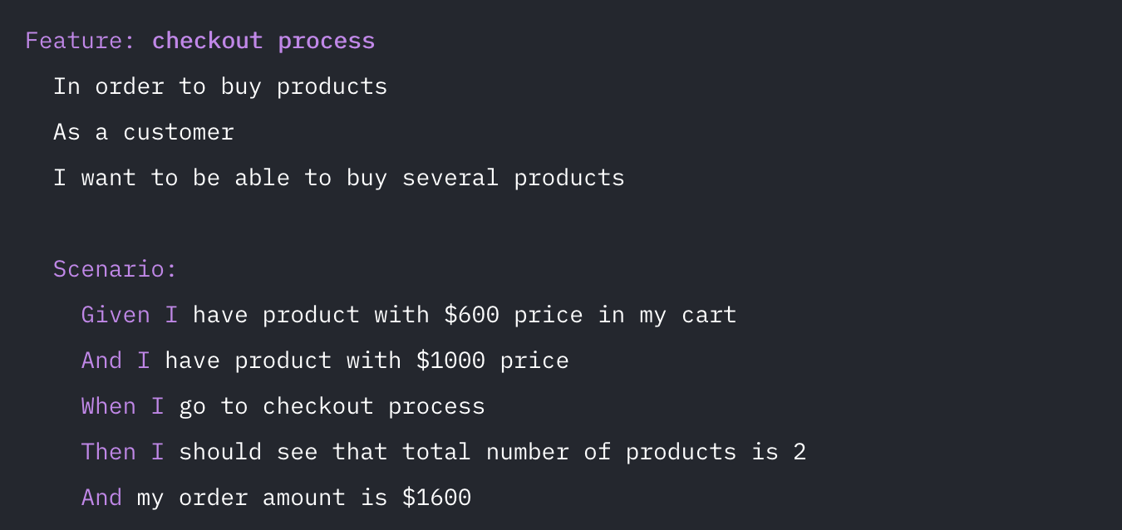
Andere tools
Selenium
Nightwatch.js
Playwright
Cypress.io
CodeceptJS

